Slide 1
Assignment #5: The Design Solution
Fall 2021
Group #3: Rachel Cook, Sara Gossman, Kimberly Kampe, Kimberly Newman

Slide 2
CONTENT
03 Background and Goal
12 Testing Strategies
The project objective and context.
The methods used to assess learners.
04 Description of Training
18 Visual Representation
Information on training modules, courses,
and requirements.
A static prototype of the course look and feel.
05 Target Population Information
Who are our learners.
06 Course Structure
A graphic depicting the flow of the course.
07 Instructional Strategies
The method of instructional delivery and design.

Slide 3
Background and Goal
Goal
The conversion of six IAPP classroom training courses and guidance documents into self-paced, web-based asynchronous training modules.
Background
Courses converted for IAPP and developed for pharmaceutical professionals.
Created in Articulate Storyline.
Accessible through Top Class8 learning management system.
Six courses consisting of four 60-minute modules per course.
Twenty-four total modules.
Courses will be narrated, interactive and engaging.
Courses will adhere to IAPP Design Plan Document and Style Guide.
Courses will be ADA compliant.
Each course will be exported in a SCORM 1.2 format.
ADDIE framework will be utilized.

Slide 4
Description of Training
Each Training Module Will Be:
Self-paced.
Web-based.
Asynchronous.
Fully narrated.
Built using the IAPP Design Plan Document and Style Guide.
The Six Courses Will Consist Of:
Four sixty-minute modules per course.
Twenty-four total modules.
Highly interactive and engaging elements.
Each Course Will Follow These Requirements:
Accessible through and compatible with IAPP's Top Class8 LMS by WBT Systems.
Delivered in a SCORM 1.2 compliant format.
Delivered in a zip file.
Supports SWF, PDF, HTML 5, Microsoft Word, and PowerPoint files.
ADA compliance.

Slide 5
Target Population Info
Our Learners Are:
Pharmaceutical industry professionals.
Members of IAPP.
Those who want/need to learn more about regulatory requirements for computerized systems in the pharmaceutical industry.
Those who want/need to explore tried, tested, and internationally-recognized methods of meeting pharmaceutical industry regulatory requirements.
Prerequisite Learner Skills & Knowledge Include:
Computer literacy.
Knowledge of LMS navigation.
Discipline and motivation to learn independently.
Notes:
Pharmaceutical professionals who are members of IAPP. The overall goal of these courses is to introduce participants to regulatory requirements for computerized systems in the pharmaceutical industry and explores tried, tested, and internationally recognized methods of meeting those requirements

Slide 6
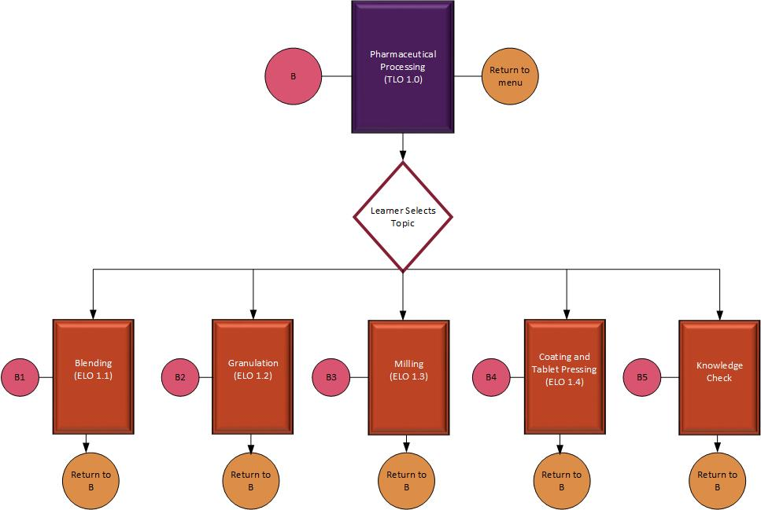
Course Structure

Slide 7
Instructional Strategy: Focus & ADA Compliance
Instructional Focus
The purpose of this curriculum is on instructing all IAPP employees on the updated processes and procedures for manufacturing and delivery of pharmaceutical supplies, as well as updates to quality assurance practices and regulation compliance protocols.
ADA Compliance
The courses will be Web Content Accessibility Guidelines (WCAG) compliant to level AA.
The courses will all be:
Perceivable
Operable
Understandable
Robust
This includes but is not limited to incorporating incorporate closed caption capability as well as pre-recorded audio, both of which the learner has the option to enable or disable, as necessary. The courses will be compliant with screen readers and keyboard functionality, providing a simple and logical layout of top-down, left-to right order. All on-screen images will be labeled for low-vision users. Any content using visual representations will have accompanying text. On-screen text will be readable, a minimum of 14-point, and high contrast. The design will be consistent, predictable, and navigable.

Slide 8
Instructional Strategy: Delivery Method
Medium of Instructional Delivery
Using Articulate Storyline, a series of 6 online training modules will be developed for IAPP to deliver, as a packaged curricula, through Top Class8 to all IAPP employees.
The courses will incorporate user-selected branching, based on their designated work area.
Learners will be guided through introductory videos, area-specific information, area-specific interactive practice and ungraded knowledge check items, before being directed to the post-test graded assessment.
Course completion will be determined based on the learner scoring 80% or above on the post-test assessment available to all learners.
Upon completion of the course, learners may proceed to the next module in the curricula.
Since the curricula is outlined to build upon information already learned, learners will not be able to skip ahead to future modules. Learners may, however, revisit modules already completed. They will also be able to stop a course partially through and return to where they left off later.

Slide 9
Instructional Strategy: Delivery Method Rationale
Medium of Instructional Delivery Rationale
Providing introductory videos to all employees allows for a baseline of information for all employees.
Providing specific information based on the designated work area allows for a deeper dive into details related to how the process or protocol impacts each learner's job.
Allowing for ungraded knowledge checks gives learners an opportunity to practice what they have learned.
Requiring 80% or above on post-test assessment items before proceeding to the next module ensures learners have grasped the concepts that will need to be built upon in the following modules.
Allowing learners to return to the course where they left off allows for flexibility, especially if a learner's time is limited.

Slide 10
Instructional Strategy: Learning Level
Level of Learning
All employees will receive an overview on the updated processes and procedures.
Employees whose workflow changes based on the changes will receive more in-depth training.
Employee training will be specific to their work area.

Slide 11
Instructional Strategy: Learning Type
Learning Type
Each module will begin with an introductory video outlining the processes in a story-telling format that is relevant to all learners.
Rationale: The videos are engaging, generate interest, and ensure each learner receives baseline information.
After the video, learners will select their work area from a list of options, like the button example below.
Rationale: Learners will receive more specific instruction, meaningful to their position.
Depending on the relevance of the process or procedure, learners will be directed through simulated practice exercises or a scaffolded "I do, we do, you do" learning structure. Some more specialized learning needs will be addressed using job aids or technical manuals.
Rationale: Providing ungraded practices solidifies the content and provided the learner with an unintimidating setting for practice.
Regulatory Affairs & Logistics
Production & Manufacturing
Engineering
Warehouse & Distribution
Sales & Marketing
Human Resources & Finance
Operations & Validation
Clinical Lab & Research
Quality Control & Quality Assurance

Slide 12
Testing Strategy: Overview
Frequency & Rationale
Learners will be assessed at the end of each of the six courses, testing their acquisition of knowledge from each module. This will allow them to be tested frequently without being slowed down or overwhelmed. Learners may also be asked short practice questions during the modules in order to emphasize and review important information.
Criteria & Rationale
Since IAPP's courses cover important skills related to pharmaceutical regulations and quality, threshold for a certificate of completion will be high. We propose at least an 80% passing score for all post-test assessments.
Alignment
The assessments will align strictly with the objectives of each module, and the results will show learners clearly whether they have satisfied those objectives.
Relevance
IAPP's learners are working professionals who will use the knowledge gained from these courses immediately in their jobs. The assessments' ability to mimic the learners' performance context, therefore, is of the utmost importance.
Medium & Rationale
All assessments will be delivered through Top Class8 LMS, per the request from IAPP and our belief that LMS programs such as Top Class8 are optimal mediums for delivering learning content. Feedback will be automated in accordance with the self-paced nature of these courses.

Slide 13
Testing Strategy: Methods & Rationale
Prior Knowledge Check
Post-Tests
Prior to each lesson, learners will be asked brief ungraded questions to assess their readiness to proceed with the module, and alert them to any deficiencies they will need to pay attention to.
The prior knowledge checks and knowledge checks will not count towards learners' final scores, as these are opportunities for learners to practice their knowledge without fear of mistakes. But, as we understand the importance of assessing learners, each of the six classes will end with an exam that will determine whether the learner may receive a certificate of completion.
Knowledge Check
Periodically within each module, learners will receive one or two work-area specific, ungraded questions to check their knowledge and ensure they are retaining important points.

Slide 14
Testing Strategy: Design Rationale
Interactivity
Accessibility
In accordance with IAPP's request that these trainings be highly interactive, rather than simply giving a text-based assessment, we will present these questions in a "real-world" environment. Learners will be walked through simulated scenarios mimicking those that they may encounter in their performance environment.
For example, they will be asked to make decisions that will mimic a conversation with a colleague, client, or patient, or which show them virtual duplications of equipment that they will have to learn to operate. In critical cases, they may be given a time limit to emphasize the sensitive nature of that particular interaction.
We understand the importance of balancing accessibility and interactivity to IAPP, and we share the belief that both are important. That's why all learners will be able to access a text-based version of the assessments, with audio narration available.
Multiple Choice
Multiple choice questions are the most frequently-used assessment types for a reason. They're easy for learners to understand and easy to grade. They are generally the only type that can be used in a self-paced course, so we will be using them throughout the modules, but with enhancements to make the assessments more relevant for learners.

Slide 15
Testing Strategy: Sample
Scenario and Script
[In this scenario, the learner is a Pharmaceutical Manufacturing Technician reviewing a work order. They will see a POV shot of hands holding a piece of paper, with the questions posed on the side of the screen]
Narrator: You receive a work order for 5,000 units of a drug to be produced over the next week. Normally, the work order is for 500 units. How should you respond?
A: The work order must contain a typo. No need to bother my boss with this. I'll just assume they meant 500.
B: This doesn't seem right, but I can't be sure. I'll ask my supervisor to double check the numbers.
C: I've heard a rumor that the bosses are looking to ramp up production of this drug. This must be a sign that it's true.
[The learner selects an answer, and is then given feedback.]
Narrator: The correct answer is B. While orders may indeed ramp up significantly from a previous manufacturing run due to a number of factors, if you see anything out of the ordinary, trust your judgment and verify.

Slide 16
Testing Strategy: Sample
Scenario and Script
[In this scenario, the learner is a Quality Control Analyst, in conversation with their supervisor. Prior to this test, they are given a list of standards for a product, including that all items must be white in color and meet certain scientific specifications when tested.]
Supervisor: This product is sorely needed in many parts of the world. I understand that the latest batch passed the specification tests but was off-color. What's your recommendation?
A: If we run one more test and document where in the chain the discoloration occurred, that should cover us for any issues.
B: The color is secondary to the scientific specifications. If the drug is needed, let's not waste any more time.
C: Unfortunately, we aren't able to release this batch. I'll have to go back in the manufacturing chain to figure out what went wrong so it won't happen again.
[Continues on next slide]

Slide 17
Testing Strategy: Sample
Scenario and Script
[The correct answer is C. If the learner chooses the correct answer, the supervisor character will say]:
Supervisor: You're right. It's unfortunate, but there is too much at stake. I appreciate your integrity.
[If the learner chooses an incorrect answer]:
Supervisor: Hm, I don't think that's best practice.
[Regardless of the answer chosen, the learner will receive the following narration]
Narrator: As the Quality Control Analyst, it is your responsibility to understand best practices, even if your supervisor isn't quite sure. Don't be pressured by outside forces to cut corners; that's your supervisor's duty to worry about. They rely on you to keep their products safe.

Slide 18
Visual Representation
Introduction Video

Slide 19
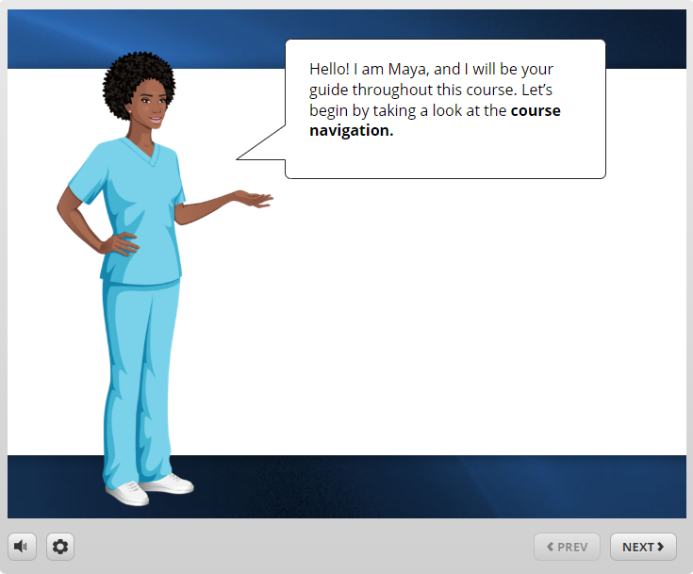
Visual Representation
Narrator Introduction/
Course Navigation Explanation

Slide 20
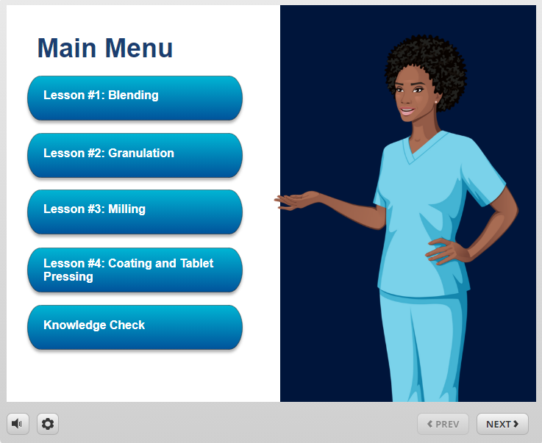
Visual Representation
Main Menu

Slide 21
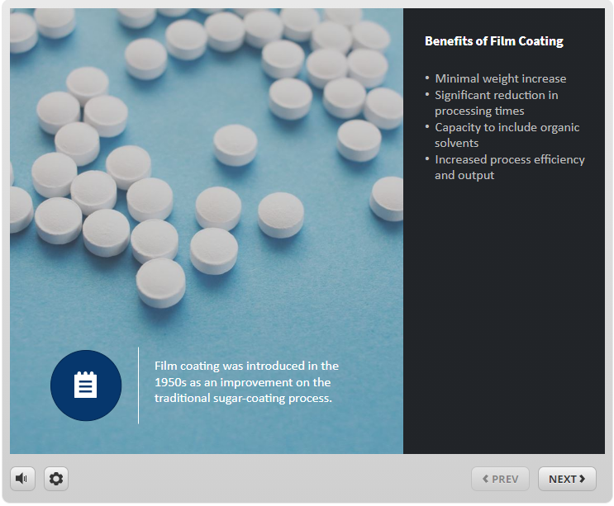
Visual Representation
Content

Slide 22
Visual Representation
Knowledge Check

